Slide 1
Countries of the Commonwealth of Independent States: Striving Together or Falling Apart?
Daria Maltseva
International laboratory for Applied Network Research
Higher School of Economics
Moscow, Russia
14th Conference of the European Sociological Association
August 20-23, 2019, Manchester

Slide 2
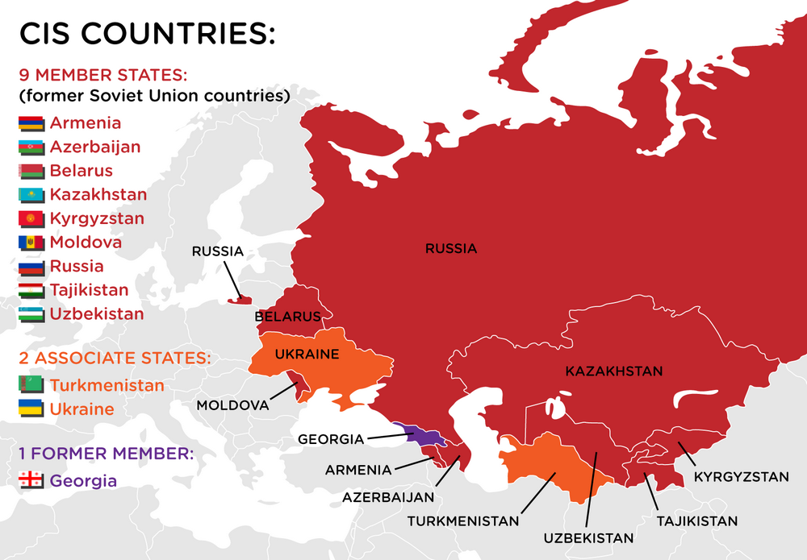
The Commonwealth of Independent States
International organization, est. 1991 to regulate relations of cooperation between the countries of the former USSR; not a supranational entity and operates on a voluntary basis.
“Based on the historical community of peoples, relations between them, taking into account the bilateral agreements, the pursuit of a democratic constitutional state, the intention to develop their relations on the basis of mutual recognition and respect for state sovereignty, the parties have agreed on the formation of the Commonwealth of Independent States”
Agreement for the CIS
- 2009
2014

Slide 3
The Commonwealth of Independent States
2011 – The agreement for the CIS Free Trade Area (all countries besides Azerbaijan and Turkmenistan; Ukraine from 2016)
2012 - Common Economic Space and Customs Union (Russia, Belarus, Kazakhstan)
2015 - Eurasian Economic Union (Armenia, Belarus, Kazakhstan, Kyrgyzstan, Russia)
2008 – “Five days war” between Georgia, South Ossetia, Abkhazia and Russia -> Georgia and Russia broke off diplomatic relations
2013 – 2014 – Euromaidan, political crisis in Ukraine, war in Donbass; Crimea joins Russia
-> Ukraine and Russia broke off diplomatic relations.
Sanctions for Russia from USA and EU.
Efforts for union and association
Real relations

Slide 4
Research question and method
What is the structure of relations between the countries of the CIS?
Social Network Analysis: The relations between countries are considered as a network, where the countries are nodes connected to each other by the links, which thickness is the indicator of their attraction or repulsion.
The studies of interactions between the countries are usually based on the actual information – flows of migration, student exchange, tourism, phone traffic, etc.
Our source: survey data from the representative mass surveys in all 12 countries.

Slide 5
Data
“Eurasian Monitor” Research Agency (since 2004)
The system of social monitoring and regular surveys of the population of the Northern Eurasia
Representative national surveys with the sample of 1050-2000 people
The common questionnaire with regular and thematic module
“Integration Barometer” Project (2012-2017)
In partnership with the Eurasian Development Bank Centre for Integration Studies
6 waves of measurement of the public mood in the post-Soviet space on the attitudes towards integration
Representative national samples of at least 1,000 people in each country

Slide 6
Data
“Integration Barometer” Project: The concept of "integration attraction"
Integration attitudes of the population
Political attraction
Which country is a friend of ours?
Economical attraction
To which countries you`ve been to in last years?
Which country is not a friend of ours?
To which countries we should provide a military support?
Military support from which countries can be accepted by us?
Which countries` goods do you prefer?
Where would you like to work?
Where would you like to live?
From which countries the arrival of the working forces is desirable?
From which countries the capital and businessmen should come from?
With which countries it is better to have a scientific exchange?
Socio-Cultural attraction
Which countries you would like to know more about?
In which countries there are people (relatives, colleagues, etc.), with whom you keep in touch?
Where would you like to go for holidays?
Where would you like to study (or to send you children to study)?
Where from the arrival of artists, and musicians is desirable?
Where from the arrival of tourists is desirable?

Slide 7
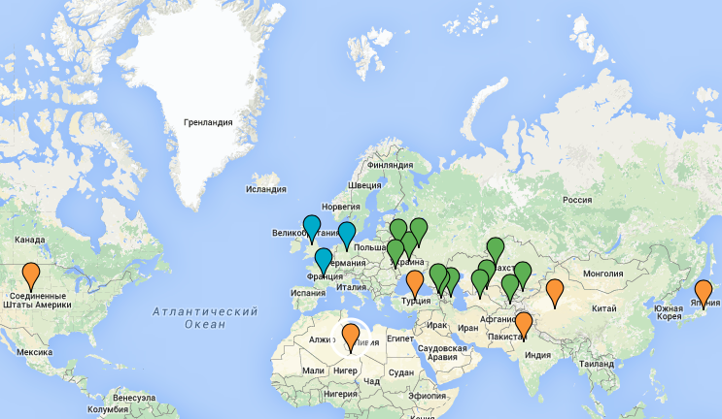
Data
“Integration Barometer” Project: Space of choices
Attraction to the EU
13 Great Britain
14 Germany
15 France
16 Other EU countries
Attraction to the Post-Soviet space
1 Azerbaijan
2 Armenia
3 Belarus
4 Georgia
5 Kazakhstan
6 Kyrgyzstan
7 Moldova
8 Russia
9 Tajikistan
10 Turkmenistan
11 Uzbekistan
12 Ukraine
Attraction to the other world
17 India
18 China
19 USA
20 Turkey
21 Japan
Countries of the Arab-Islamic world (Middle East and North Africa)
Other countries
“Autonomy”
24 There is no such countries
25 Difficult to answer

Slide 8
Data
Networks construction
Issue | Questions | Mode | N of countries
Association | Currently, some countries aim to unite with others, while other countries, otherwise, aim to be independent. If it would be of your choice, with which of the countries specified on the card, will it be right to unite for our country? | General perception | 14
Friendship and non-friendship | Which countries among listed below are friends to our country (can be reliable in hard times)? Which countries among listed below are NOT friends to our country (having conflict and carrying a threat to our country)? | General perception | 23
Communication | In which of the following countries do you have relatives, close friends, colleagues with whom you maintain a permanent connection (in person, by mail, phone, etc.)? | Real practice | 23
Migration | To which of the following countries would you like to move to a permanent place of residence if you had such an opportunity? | Strong social setting | 23
General attraction | 17 questions from the survey | General perception | 12

Slide 9
Data
Networks construction
Year | 2012 | 2013 | 2014 | 2015 | 2016 | 2017
N of countries in the survey | 11 | 12 | 11 | 9 | 7 | 7
Period | 2012-2013 |  | 2014-2015 |  | 2016-2017
Networks:
Link weight – values (%)
Node weighted indegree – N of incoming ties, taking into account their weights
Year | Azerbaijan | Armenia | Belarus | Georgia | Kazakhstan | … | … | … | … | Great Britain | China | …
Azerbaijan |  | 0% | 4% | 11% | 4% | 2% | 2% | 6% | 6% | 0% | 0% | 0%
Armenia | 0% |  | 5% | 7% | 4% | 2% | 2% | 7% | 1% | 0% | 0% | 0%
Belarus | 6% | 4% |  | 2% | 12% | 5% | 5% | 19% | 4% | 0% | 0% | 0%
Georgia | 13% | 9% | 4% |  | 3% | 3% | 2% | 4% | 1% | 0% | 0% | 0%
Kazakhstan | 7% | 2% | 12% | 2% |  | 19% | 2% | 12% | 11% | 0% | 0% | 0%
… | 3% | 2% | 4% | 1% | 10% |  | 2% | 5% | 8% | 0% | 0% | 0%
… | 5% | 2% | 4% | 2% | 4% | 2% |  | 6% | 2% | 0% | 0% | 0%
… | 19% | 47% | 40% | 11% | 49% | 50% | 40% |  | 57% | 0% | 0% | 0%
… | 3% | 2% | 4% | 1% | 5% | 3% | 2% | 5% |  | 0% | 0% | 0%
Great Britain | 5% | 1% | 4% | 1% | 5% | 4% | 2% | 4% | 5% | 0% | 0% | 0%
China | 6% | 1% | 4% | 1% | 8% | 6% | 2% | 5% | 5% | 0% | 0% | 0%
…. | 11% | 6% | 18% | 17% | 8% | 3% | 17% | 14% | 3% | 0% | 0% | 0%

Slide 10
Results

Slide 11
Association:
The future of the union?
Do you think that in the next 5 years the CIS countries (the former USSR) will become closer or move away from each other?
Will become closer
Move away from each other

Slide 12
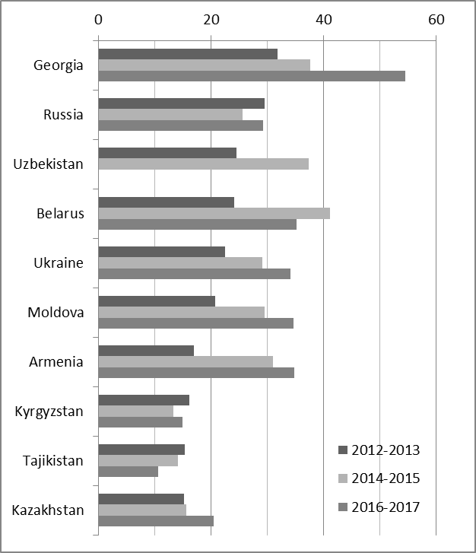
Association:
With whom to unite?
Weighted indegree
“There are no such countries”
 |  | 2012 - 2013 |  |  | 2014 – 2015 |  |  | 2016 – 2017
 |  | Value | Id |  | Value | Id |  | Value | Id
1 |  | 473.3 | Russia |  | 447.7 | Russia |  | 344.7 | Russia
2 |  | 198.4 | EU countries |  | 162.9 | EU countries |  | 152.3 | EU countries
3 |  | 123.6 | Belarus |  | 139.8 | Belarus |  | 109.6 | Belarus
4 |  | 118.7 | Kazakhstan |  | 134.7 | Kazakhstan |  | 107.1 | Kazakhstan
5 |  | 105.9 | Ukraine |  | 72.8 | Kyrgyzstan |  | 66.7 | Ukraine
6 |  | 56.4 | Turkey |  | 71.8 | Armenia |  | 66.4 | Armenia
7 |  | 51.7 | Uzbekistan |  | 67.2 | Azerbaijan |  | 66.2 | Kyrgyzstan
8 |  | 50.2 | Kyrgyzstan |  | 66.9 | Turkmenistan |  | 61.2 | Azerbaijan
9 |  | 47.9 | Azerbaijan |  | 64.6 | Turkey |  | 54.7 | Georgia
10 |  | 41.2 | Turkmenistan |  | 53.3 | Ukraine |  | 50.7 | Turkmenistan
11 |  | 40.3 | Armenia |  | 52.7 | Georgia |  | 47.5 | Uzbekistan
12 |  | 34.2 | Moldova |  | 50.4 | Moldova |  | 46.9 | Moldova
13 |  | 32.2 | Georgia |  | 46.6 | Uzbekistan |  | 46.1 | Turkey
14 |  | 26.04 | Tajikistan |  | 45.6 | Tajikistan |  | 43.1 | Tajikistan

Slide 13
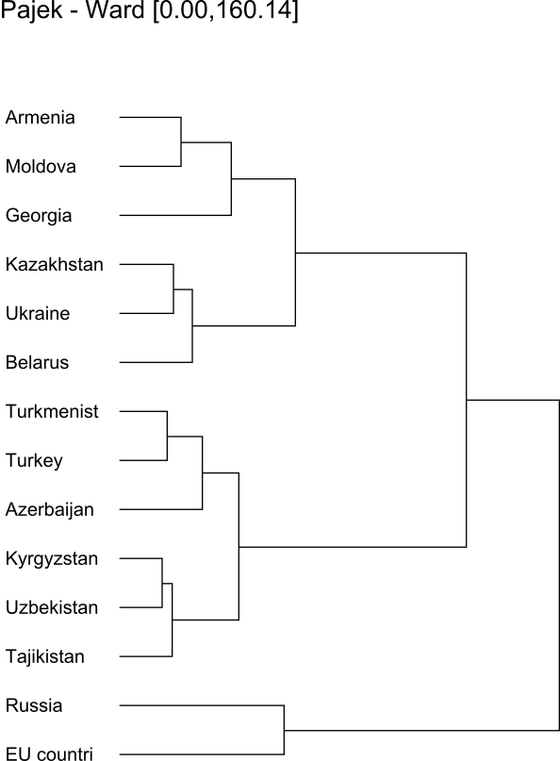
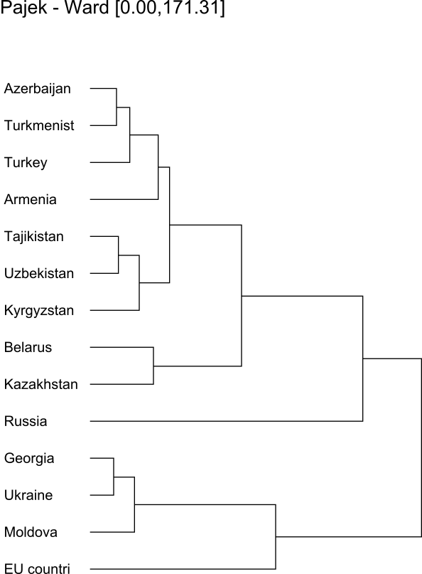
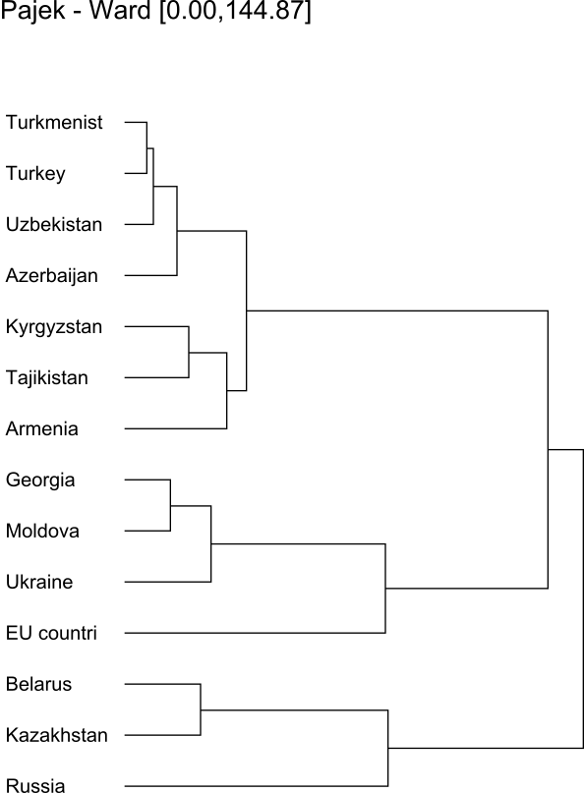
Association:
With whom to unite?
2012-2013
2014-2015
2016-2017

Slide 14
Association:
With whom to unite?
2012-2013
2014-2015
2016-2017

Slide 15
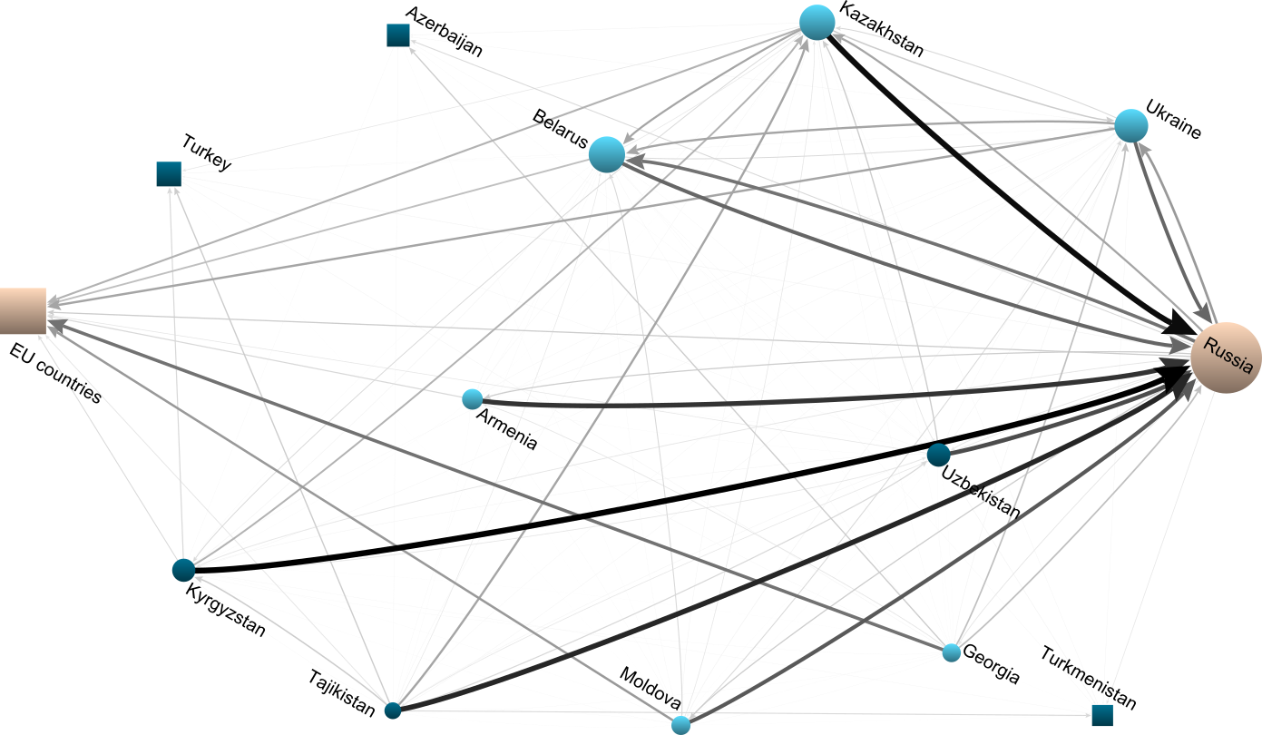
Association:
With whom to unite?
2012-2013
Two poles of attraction: Russia and EU countries
Reciprocal connections between Russia, Belarus, Kazakhstan, and Ukraine.
Russia is attractive for Kyrgyzstan, Tajikistan, Armenia, and Uzbekistan.
Georgia and Moldova are oriented to EU countries.

Slide 16
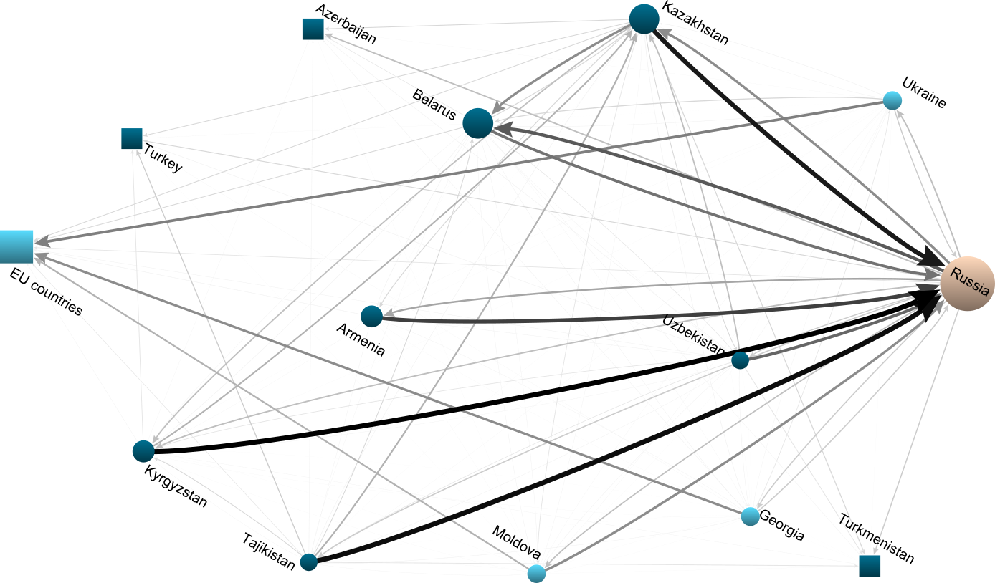
Association:
With whom to unite?
2014-2015
Ukraine changes its orientation towards the EU countries.

Slide 17
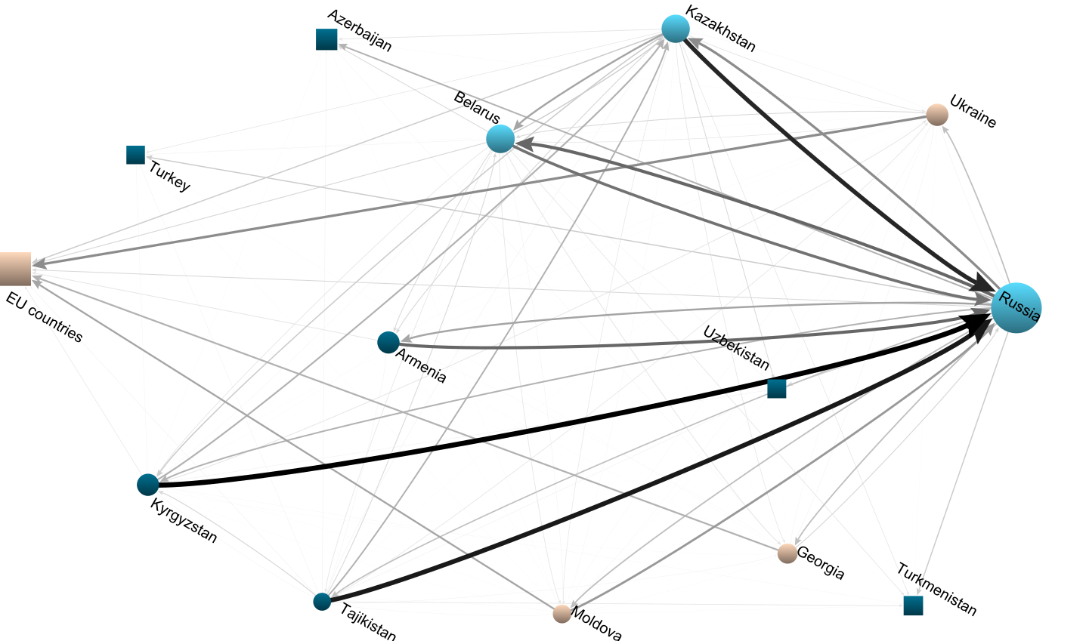
Association:
With whom to unite?
2016-2017
Reciprocal connections between Russia, Belarus, and Kazakhstan.
Russia is attractive for Kyrgyzstan, Tajikistan, and Armenia.
Ukraine, Georgia, and Moldova are oriented to EU countries.

Slide 18
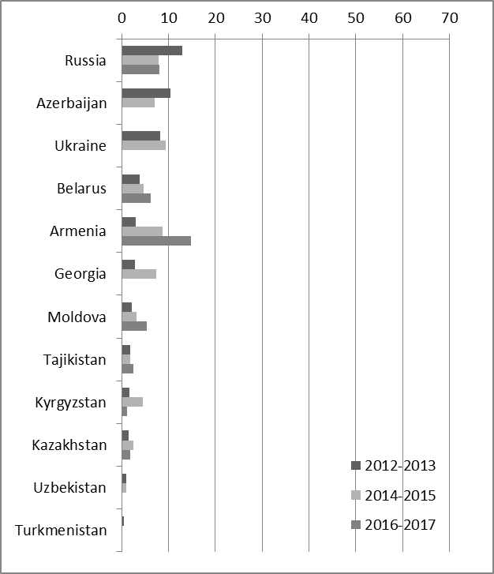
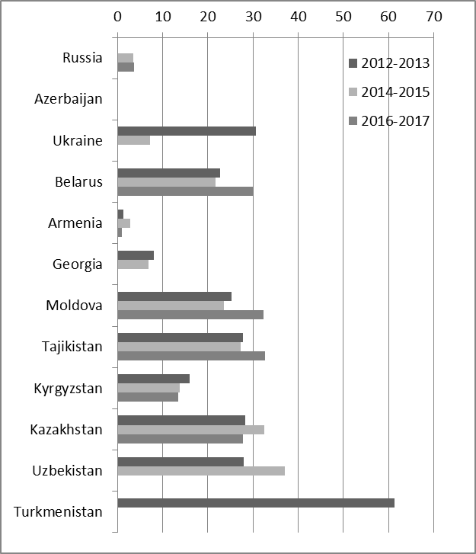
Friendship:
Who are the friends and non-friends?
Friendship
Non-friends
“There are no such countries”

Slide 19
Friendship:
Who are the friends and non-friends?
Friendship Indegree
Non-friends Indegree
 |  | 2012 - 2013 |  |  | 2014 – 2015 |  |  | 2016 – 2017
 |  | Value | Id |  | Value | Id |  | Value | Id
1 |  | 735.9 | Russia |  | 607.0 | Russia |  | 454.4 | Russia
2 |  | 302.3 | Ukraine |  | 250.5 | Kazakhstan |  | 176.6 | Kazakhstan
3 |  | 273.7 | Kazakhstan |  | 218.7 | Belarus |  | 140.1 | Belarus
4 |  | 264.9 | Belarus |  | 179.3 | Turkey |  | 121.8 | China
5 |  | 176.2 | Turkey |  | 162.3 | Ukraine |  | 110.6 | Kyrgyzstan
6 |  | 168.8 | France |  | 157.6 | China |  | 103.5 | Armenia
7 |  | 164.3 | Azerbaijan |  | 153.1 | Georgia |  | 94.3 | Uzbekistan
8 |  | 162.1 | Germany |  | 149.7 | Germany |  | 85.2 | Azerbaijan
9 |  | 157.9 | USA |  | 149.6 | Azerbaijan |  | 83.2 | France
10 |  | 143.7 | China |  | 142.2 | France |  | 82.0 | Georgia
11 |  | 137.7 | Georgia |  | 141.4 | Armenia |  | 75.6 | Turkmenistan
12 |  | 125.4 | Armenia |  | 128.0 | USA |  | 72.1 | Germany
13 |  | 124.7 | Kyrgyzstan |  | 126.7 | Kyrgyzstan |  | 63.7 | Tajikistan
14 |  | 124.0 | Uzbekistan |  | 112.0 | Turkmenistan |  | 62.6 | Ukraine
15 |  | 111.9 | Moldova |  | 97.7 | Other EU |  | 58.5 | Other EU
16 |  | 106.8 | Turkmenistan |  | 97.5 | Moldova |  | 57.8 | Moldova
17 |  | 95.6 | Great Britain |  | 95.7 | Great Britain |  | 52.0 | India
18 |  | 92.5 | Other EU |  | 93.1 | Uzbekistan |  | 51.0 | Turkey
19 |  | 89.4 | Tajikistan |  | 86.0 | Tajikistan |  | 42.2 | Great Britain
20 |  | 74.9 | Japan |  | 78.6 | India |  | 37.3 | USA
21 |  | 72.8 | Middle East … |  | 63.6 | Japan |  | 30.9 | Japan
22 |  | 72.7 | India |  | 54.6 | Middle East … |  | 21.0 | Middle East …
23 |  | 15.3 | Other countries |  | 13.4 | Other countries |  | 6.6 | Other countries
 |  | 2012 - 2013 |  |  | 2014 – 2015 |  |  | 2016 – 2017
 |  | Value | Id |  | Value | Id |  | Value | Id
1 |  | 136.8 | Russia |  | 212.8 | USA |  | 164.1 | USA
2 |  | 117.0 | Armenia |  | 186.5 | Russia |  | 127.0 | Turkey
3 |  | 109.6 | Azerbaijan |  | 118.7 | Armenia |  | 103.7 | Azerbaijan
4 |  | 107.4 | Uzbekistan |  | 104.0 | Azerbaijan |  | 99.1 | Ukraine
5 |  | 96.8 | USA |  | 88.2 | Turkey |  | 77.1 | Uzbekistan
6 |  | 91.5 | Turkey |  | 87.3 | Uzbekistan |  | 43.5 | Germany
7 |  | 62.2 | Tajikistan |  | 82.4 | Ukraine |  | 39.7 | Middle East …
8 |  | 59.1 | Middle East … |  | 58.9 | Tajikistan |  | 38.8 | Great Britain
9 |  | 40.4 | China |  | 57.2 | Germany |  | 32.5 | China
10 |  | 38.8 | Kyrgyzstan |  | 56.9 | Great Britain |  | 28.5 | Russia
11 |  | 36.4 | France |  | 50.3 | France |  | 28.4 | Other EU
12 |  | 32.4 | Germany |  | 43.1 | Middle East … |  | 27.1 | France
13 |  | 30.1 | Georgia |  | 34.5 | Georgia |  | 23.2 | Tajikistan
14 |  | 29.3 | Other EU |  | 32.1 | Kyrgyzstan |  | 23.0 | Georgia
15 |  | 26.1 | Turkmenistan |  | 30.5 | China |  | 15.4 | Japan
16 |  | 24.6 | Great Britain |  | 27.2 | Other EU |  | 13.3 | Kyrgyzstan
17 |  | 18.2 | Kazakhstan |  | 19.2 | Japan |  | 9.6 | Turkmenistan
18 |  | 14.7 | Ukraine |  | 14.4 | Turkmenistan |  | 8.7 | Kazakhstan
19 |  | 13.0 | Belarus |  | 12.7 | Kazakhstan |  | 8.2 | Armenia
20 |  | 8.3 | Japan |  | 11.2 | Moldova |  | 7.5 | Moldova
21 |  | 8.2 | Other countries |  | 10.3 | Belarus |  | 6.4 | Belarus
22 |  | 6.6 | Moldova |  | 6 | India |  | 5.5 | India
23 |  | 6.6 | India |  | 5.7 | Other countries |  | 4.0 | Other countries

Slide 20
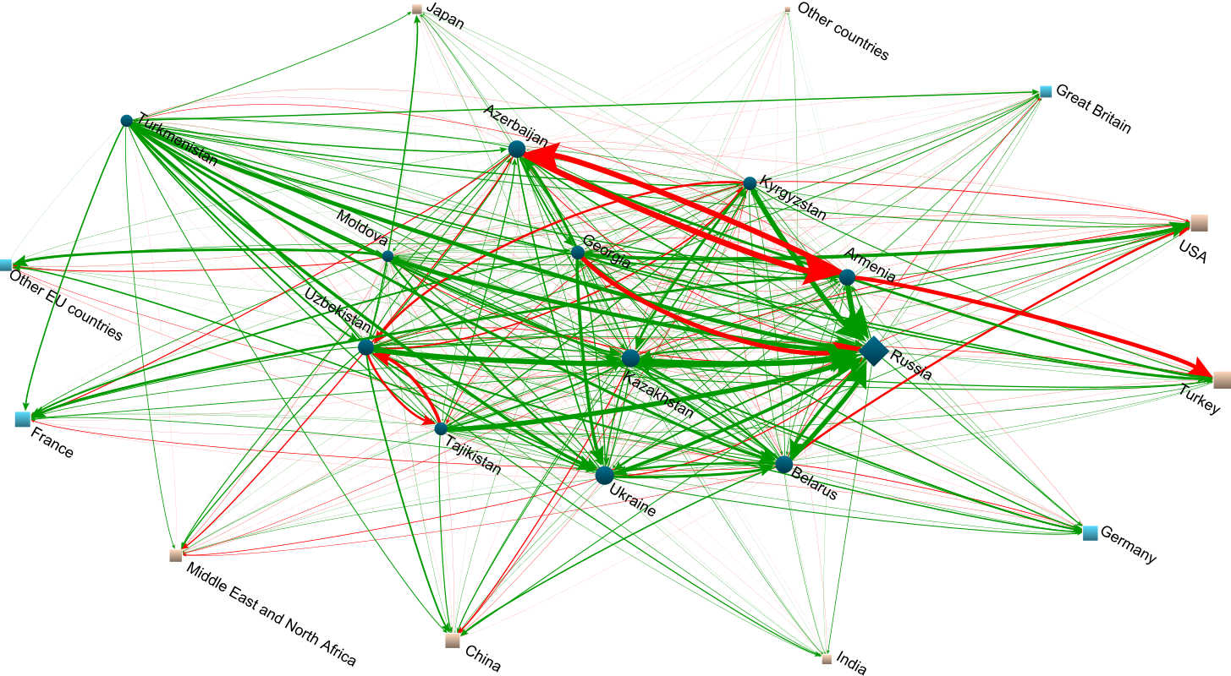
Friendship:
Who are the friends and non-friends?
2012-2013
Most of the ties are positive.
Mutual negative ties between
Azerbaijan and Armenia,
Uzbekistan and Tajikistan,
Kyrgyzstan and Uzbekistan.
Negative one-way ties from
Georgia to Russia,
Armenia to Turkey,
Belarus to USA.

Slide 21
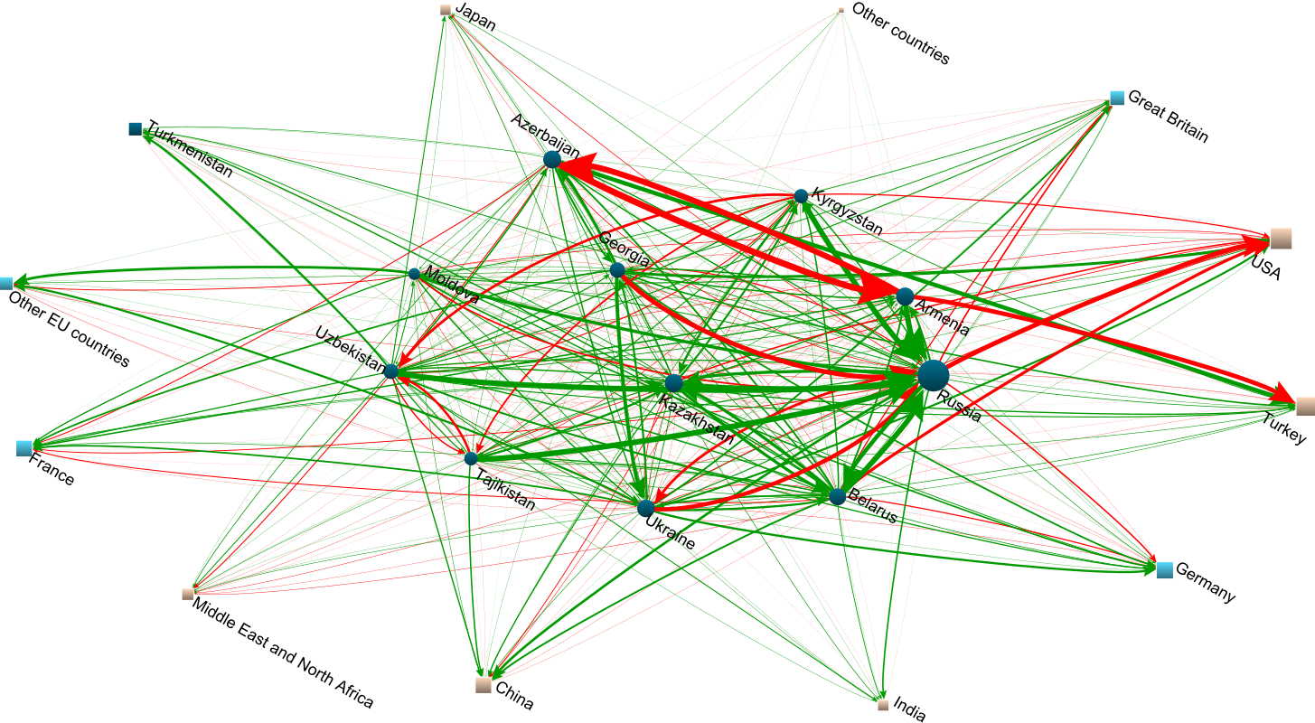
Friendship:
Who are the friends and non-friends?
2014-2015
Mutual negative ties appears between
Russia and Ukraine
Negative one-way ties from
Russia to USA and Great Britain,
Belarus to Great Britain.

Slide 22
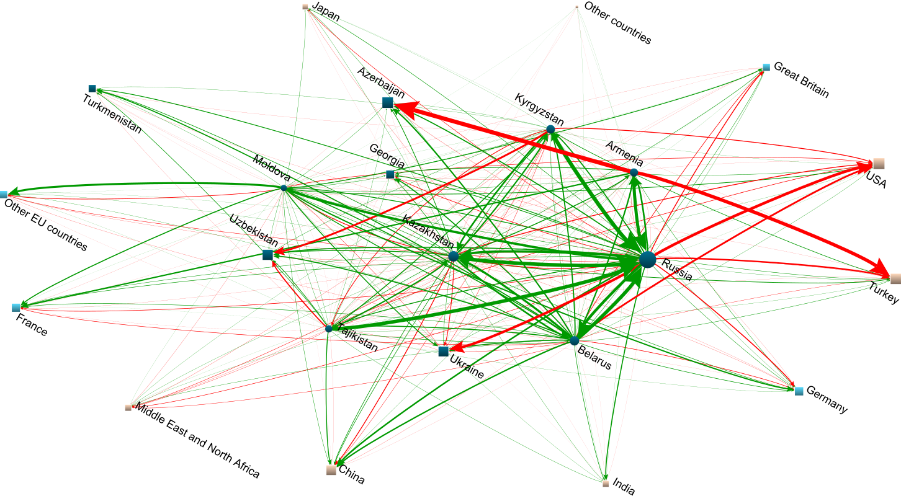
Friendship:
Who are the friends and non-friends?
2016-2017
Negative one-way ties from Russia to Turkey.
Middle East and North Africa are seen unfriendly by many countries.
China is seen as enemy by Kazakhstan in all years.

Slide 23
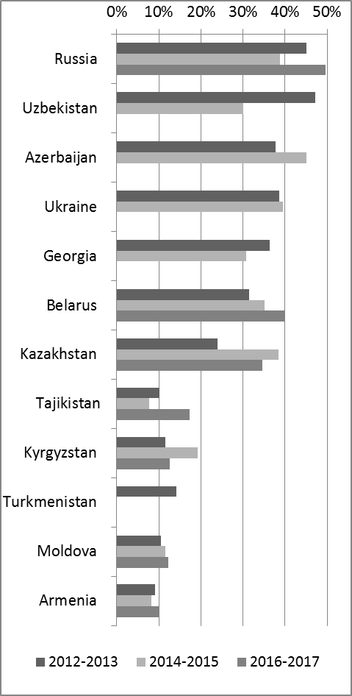
Communication:
With whom you maintain a permanent connection?
2012-2013
1 | 527 | Russia
2 | 109 | Ukraine
3 | 83 | Other EU countries
4 | 73 | USA
5 | 68 | Germany
6 | 49 | Kazakhstan
7 | 42 | Turkey
8 | 41 | Uzbekistan
9 | 37 | France
10 | 36 | Belarus
11 | 18 | Georgia
12 | 14 | China
13 | 13 | Great Britain
14 | 11 | Other countries
15 | 11 | Kyrgyzstan
16 | 11 | Middle East and North Africa
17 | 10 | Moldova
18 | 8 | Tajikistan
19 | 8 | Azerbaijan
20 | 7 | Armenia
21 | 5 | Turkmenistan
22 | 2 | Japan
23 | 1 | India
2014-2015
1 | 490 | Russia
2 | 93 | Ukraine
3 | 84 | Other EU countries
4 | 62 | Germany
5 | 54 | USA
6 | 45 | Kazakhstan
7 | 39 | Turkey
8 | 32 | France
9 | 28 | Belarus
10 | 23 | Uzbekistan
11 | 22 | Georgia
12 | 15 | Great Britain
13 | 12 | Other countries
14 | 8 | Kyrgyzstan
15 | 8 | Moldova
16 | 8 | China
17 | 7 | Middle East and North Africa
18 | 5 | Tajikistan
19 | 5 | Azerbaijan
20 | 4 | Armenia
21 | 3 | Turkmenistan
22 | 2 | India
23 | 0 | Japan
2016-2017
1 | 330 | Russia
2 | 64 | Ukraine
3 | 57 | Other EU countries
4 | 55 | Germany
5 | 42 | USA
6 | 31 | France
7 | 30 | Kazakhstan
8 | 28 | Uzbekistan
9 | 17 | Belarus
10 | 16 | Turkey
11 | 14 | Great Britain
12 | 13 | Georgia
13 | 9 | Kyrgyzstan
14 | 8 | China
15 | 7 | Other countries
16 | 5 | Moldova
17 | 3 | Armenia
18 | 2 | Azerbaijan
19 | 2 | India
20 | 1 | Middle East and North Africa
21 | 1 | Turkmenistan
22 | 1 | Tajikistan
23 | 0 | Japan
“There are no such countries”

Slide 24
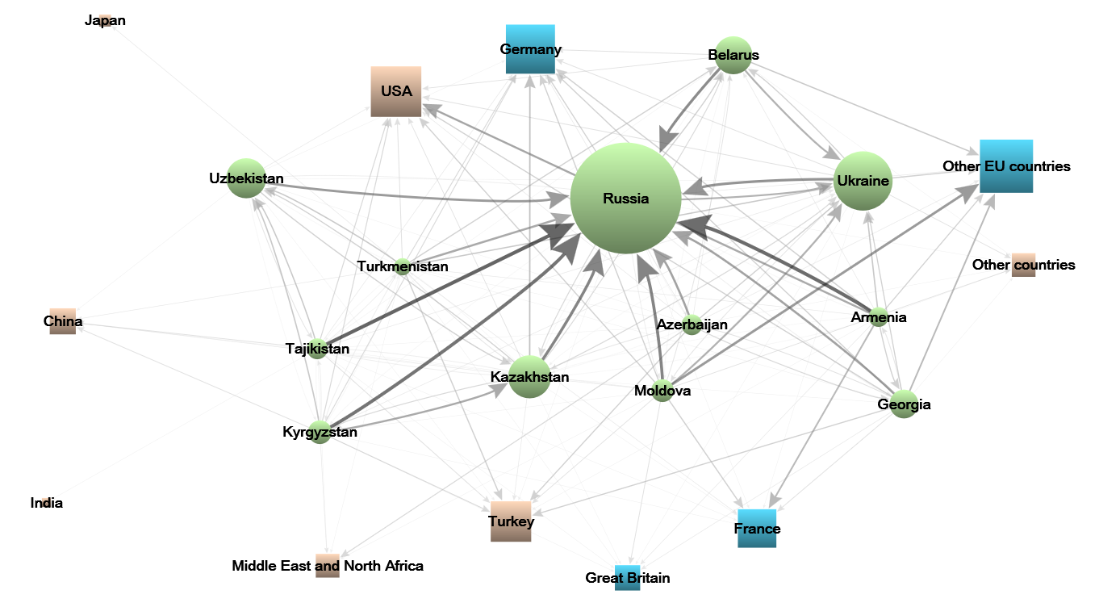
Communication:
With whom you maintain a permanent connection?
2012-2013

Slide 25
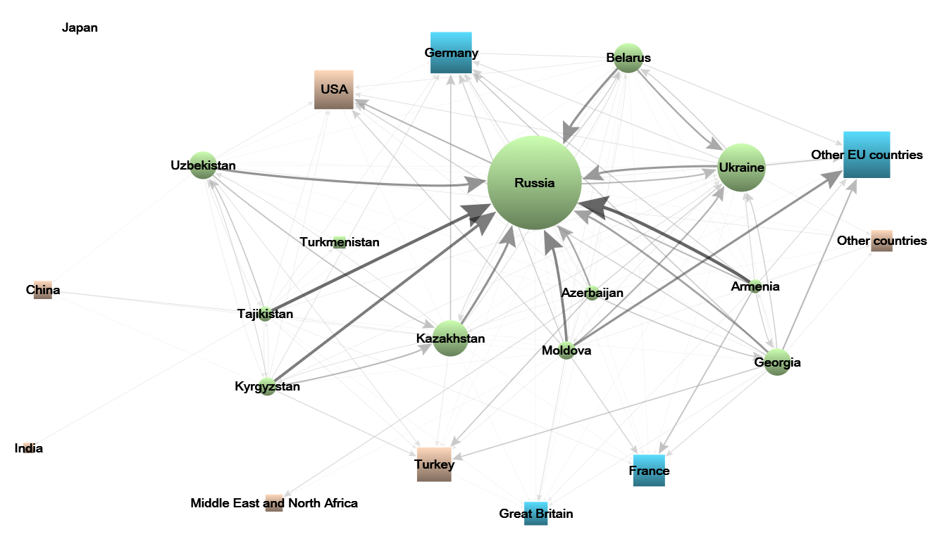
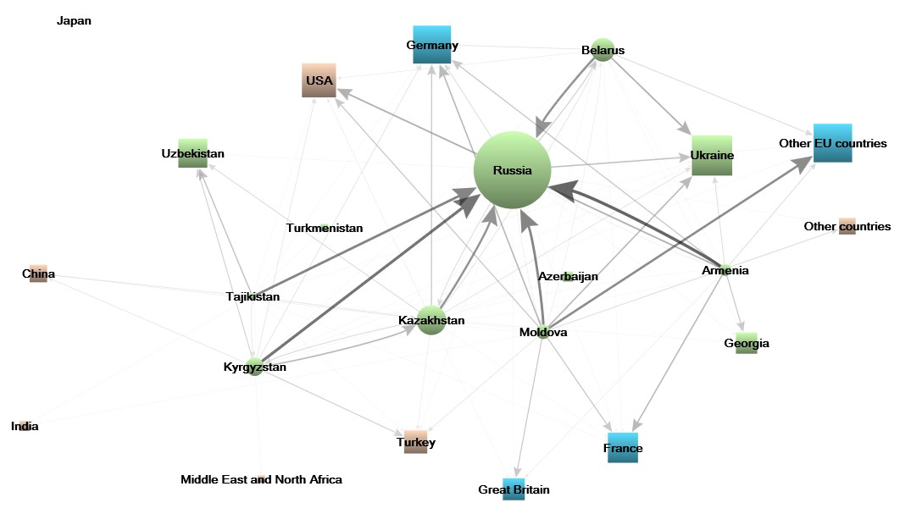
Communication:
With whom you maintain a permanent connection?
2014-2015
2016-2017
Russia is the country with which the residents of other CIS countries have the most intense communications.
Other countries with whom the relations are maintained – Ukraine, Other EU countries, Germany and USA. They are not (except Ukraine) countries from the CIS.
Armenia, Azerbaijan, Turkmenistan, Tajikistan (CIS) and India & Japan (non-CIS) are the countries with which people from other countries do not maintain active communication.
The relations with Armenia and Moldova are not reciprocal – they nominate the highest number of contacts, but they are not nominated. And they actively nominate EU countries.

Slide 26
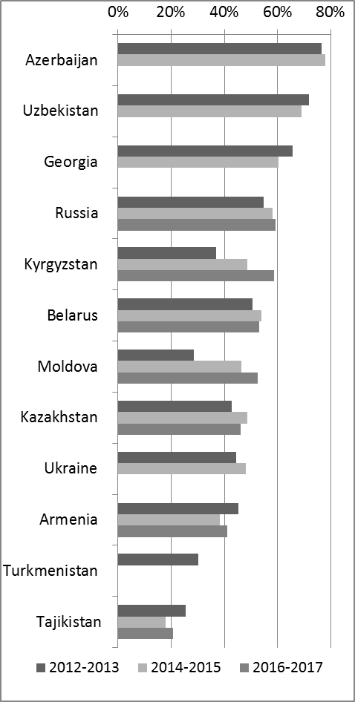
Migration attraction
Where to move to a permanent place of residence?
2012-2013
1 | 147 | Russia
2 | 72 | USA
3 | 67 | Germany
4 | 45 | France
5 | 36 | Other EU countries
6 | 32 | Great Britain
7 | 25 | Turkey
8 | 15 | Middle East and North Africa
9 | 10 | Ukraine
10 | 8 | Japan
11 | 6 | Belarus
12 | 6 | Kazakhstan
13 | 6 | China
14 | 5 | Other countries
15 | 3 | India
16 | 2 | Uzbekistan
17 | 2 | Turkmenistan
18 | 1 | Georgia
19 | 0 | Moldova
20 | 0 | Armenia
21 | 0 | Tajikistan
22 | 0 | Azerbaijan
23 | 0 | Kyrgyzstan
2014-2015
1 | 124 | Russia
2 | 60 | Germany
3 | 54 | USA
4 | 38 | France
5 | 31 | Other EU countries
6 | 30 | Great Britain
7 | 20 | Turkey
8 | 10 | Middle East and North Africa
9 | 9 | Japan
10 | 9 | China
11 | 8 | Kazakhstan
12 | 5 | Ukraine
13 | 4 | Other countries
14 | 4 | Belarus
15 | 2 | Georgia
16 | 2 | Uzbekistan
17 | 2 | India
18 | 1 | Turkmenistan
19 | 0 | Moldova
20 | 0 | Armenia
21 | 0 | Azerbaijan
22 | 0 | Tajikistan
23 | 0 | Kyrgyzstan
2016-2017
1 | 89 | Russia
2 | 40 | Germany
3 | 38 | USA
4 | 24 | France
5 | 17 | Great Britain
6 | 15 | Other EU countries
7 | 11 | Turkey
8 | 4 | Middle East and North Africa
9 | 4 | Japan
10 | 4 | China
11 | 3 | Other countries
12 | 3 | Kazakhstan
13 | 2 | Belarus
14 | 2 | Kyrgyzstan
15 | 2 | Uzbekistan
16 | 2 | India
17 | 1 | Turkmenistan
18 | 0 | Moldova
19 | 0 | Ukraine
20 | 0 | Azerbaijan
21 | 0 | Georgia
22 | 0 | Tajikistan
23 | 0 | Armenia
“There are no such countries”
Russia is the most attractive country according to migration; other attractive countries are USA, EU countries, and Middle East and North Africa.
The least attractive countries are Armenia, Azerbaijan, Georgia, Moldova, Tajikistan, and Ukraine (which lost its position).

Slide 27
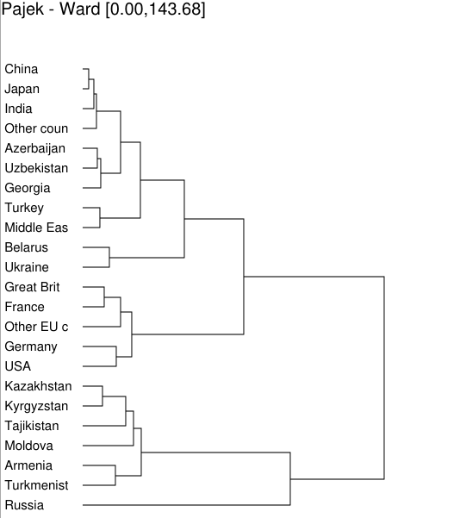
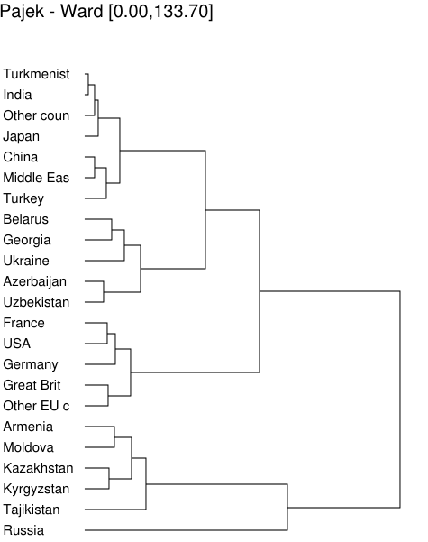
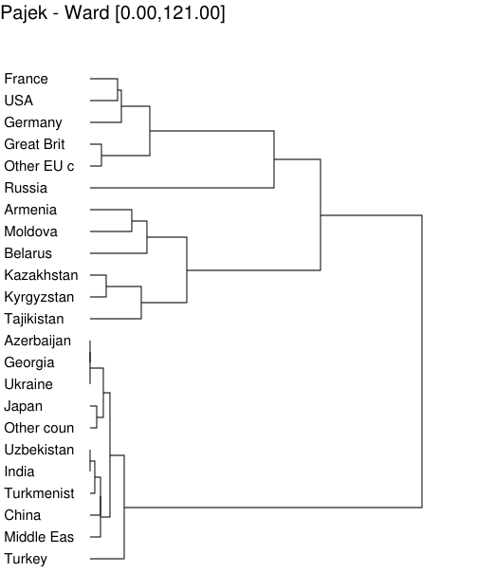
Migration attraction
Where to move to a permanent place of residence?
2012-2013
2014-2015
2016-2017
2
3
1
4
According to the results of Hierarchical clustering (Ward), the countries form 4 clusters:
1) CIS countries mostly oriented to Russia 3) Developed European countries and USA
2) CIS countries oriented to Russia and other countries 4) Russia, which has a separate position.

Slide 28
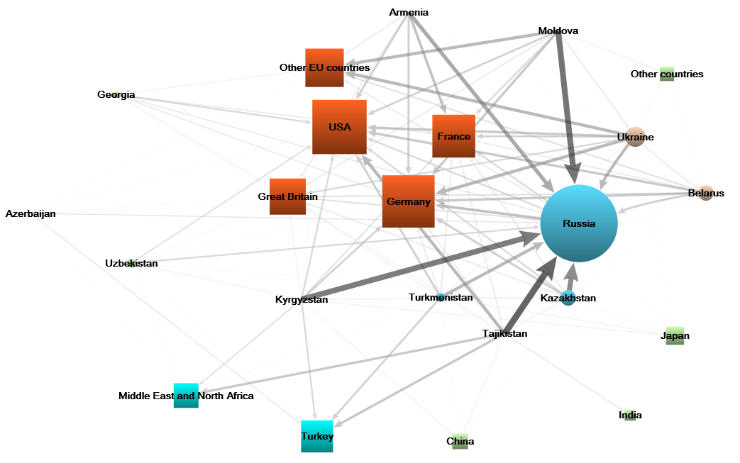
Migration attraction
Where to move to a permanent place of residence?
2012-2013

Slide 29
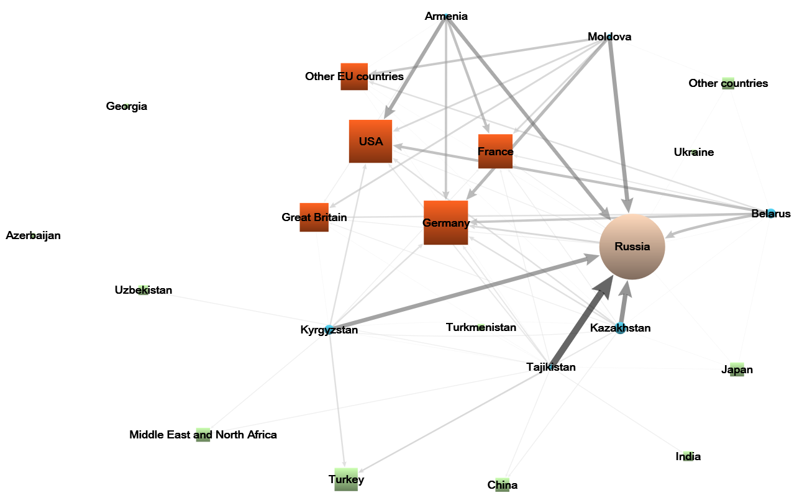
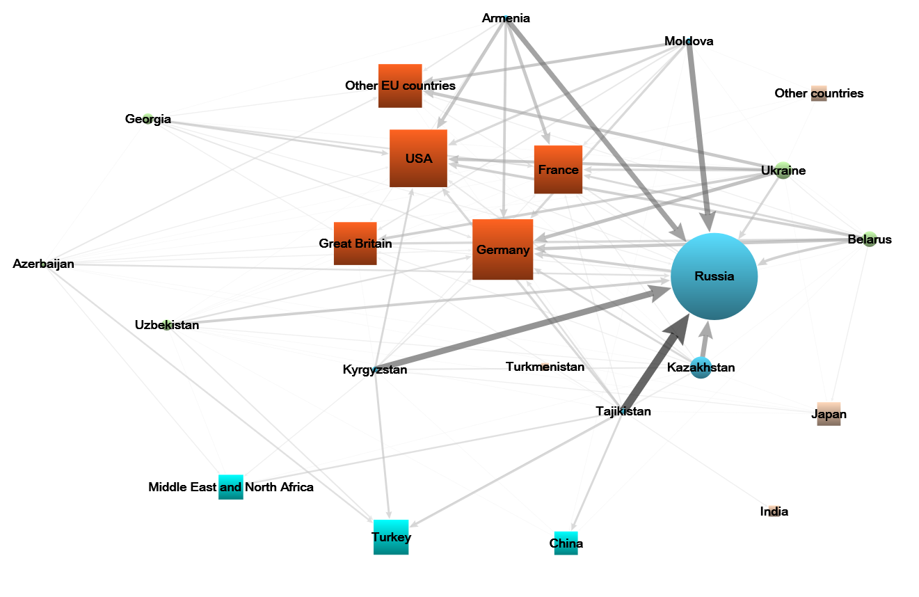
Migration attraction
Where to move to a permanent place of residence?
2014-2015
2016-2017

Slide 30
General attraction
2012 - 2013
Rank | Value | Id
1 | 425 | Russia
2 | 121 | Ukraine
3 | 97 | Kazakhstan
4 | 91 | Belarus
5 | 53 | Georgia
6 | 50 | Kyrgyzstan
7 | 50 | Uzbekistan
8 | 49 | Azerbaijan
9 | 42 | Turkmenistan
10 | 40 | Armenia
11 | 40 | Moldova
12 | 39 | Tajikistan
Sum | 1097
2014 - 2015
Rank | Value | Id
1 | 366 | Russia
2 | 95 | Kazakhstan
3 | 83 | Belarus
4 | 76 | Ukraine
5 | 63 | Georgia
6 | 50 | Kyrgyzstan
7 | 50 | Azerbaijan
8 | 47 | Armenia
9 | 44 | Uzbekistan
10 | 37 | Moldova
11 | 35 | Tajikistan
Sum | 946
2016 - 2017
Rank | Value | Id
1 | 258 | Russia
2 | 69 | Kazakhstan
3 | 57 | Belarus
4 | 45 | Kyrgyzstan
5 | 42 | Armenia
6 | 28 | Tajikistan
7 | 27 | Moldova
Sum | 526
The most attractive country in all waves of study is Russia followed by Kazakhstan, Belarus, and Ukraine (2012-2015), the latter has notably changed its position.
The least attractive countries are Tajikistan and Moldova.
Countries with the highest level of orientation to other CIS members for all waves are Belarus and Kazakhstan; in 2012-2015 Uzbekistan and Tajikistan also had quite a high level of orientation.
Countries with the lowest level of orientation to other CIS members are Georgia, Armenia, Moldova, and Azerbaijan.

Slide 31
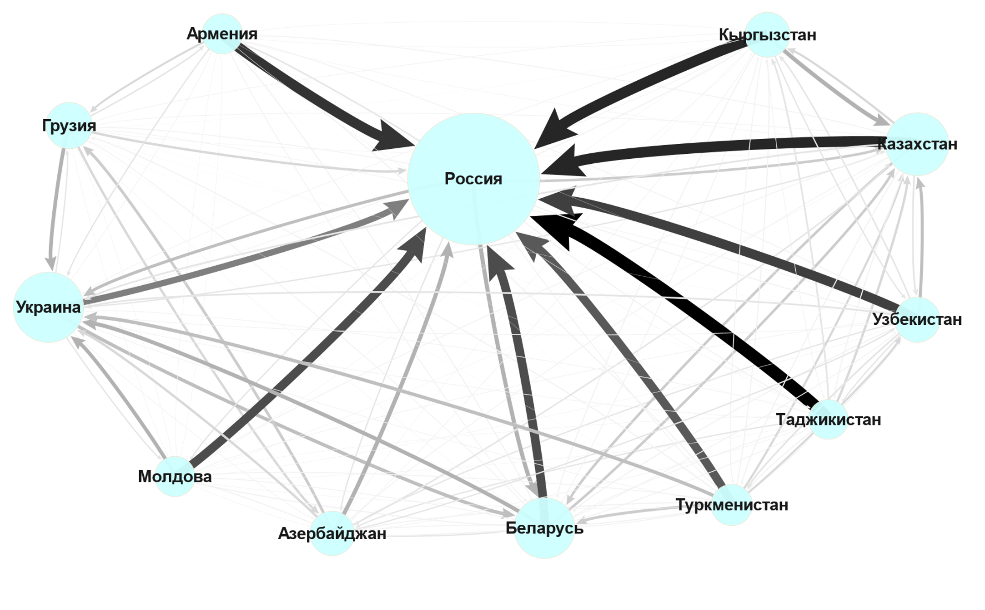
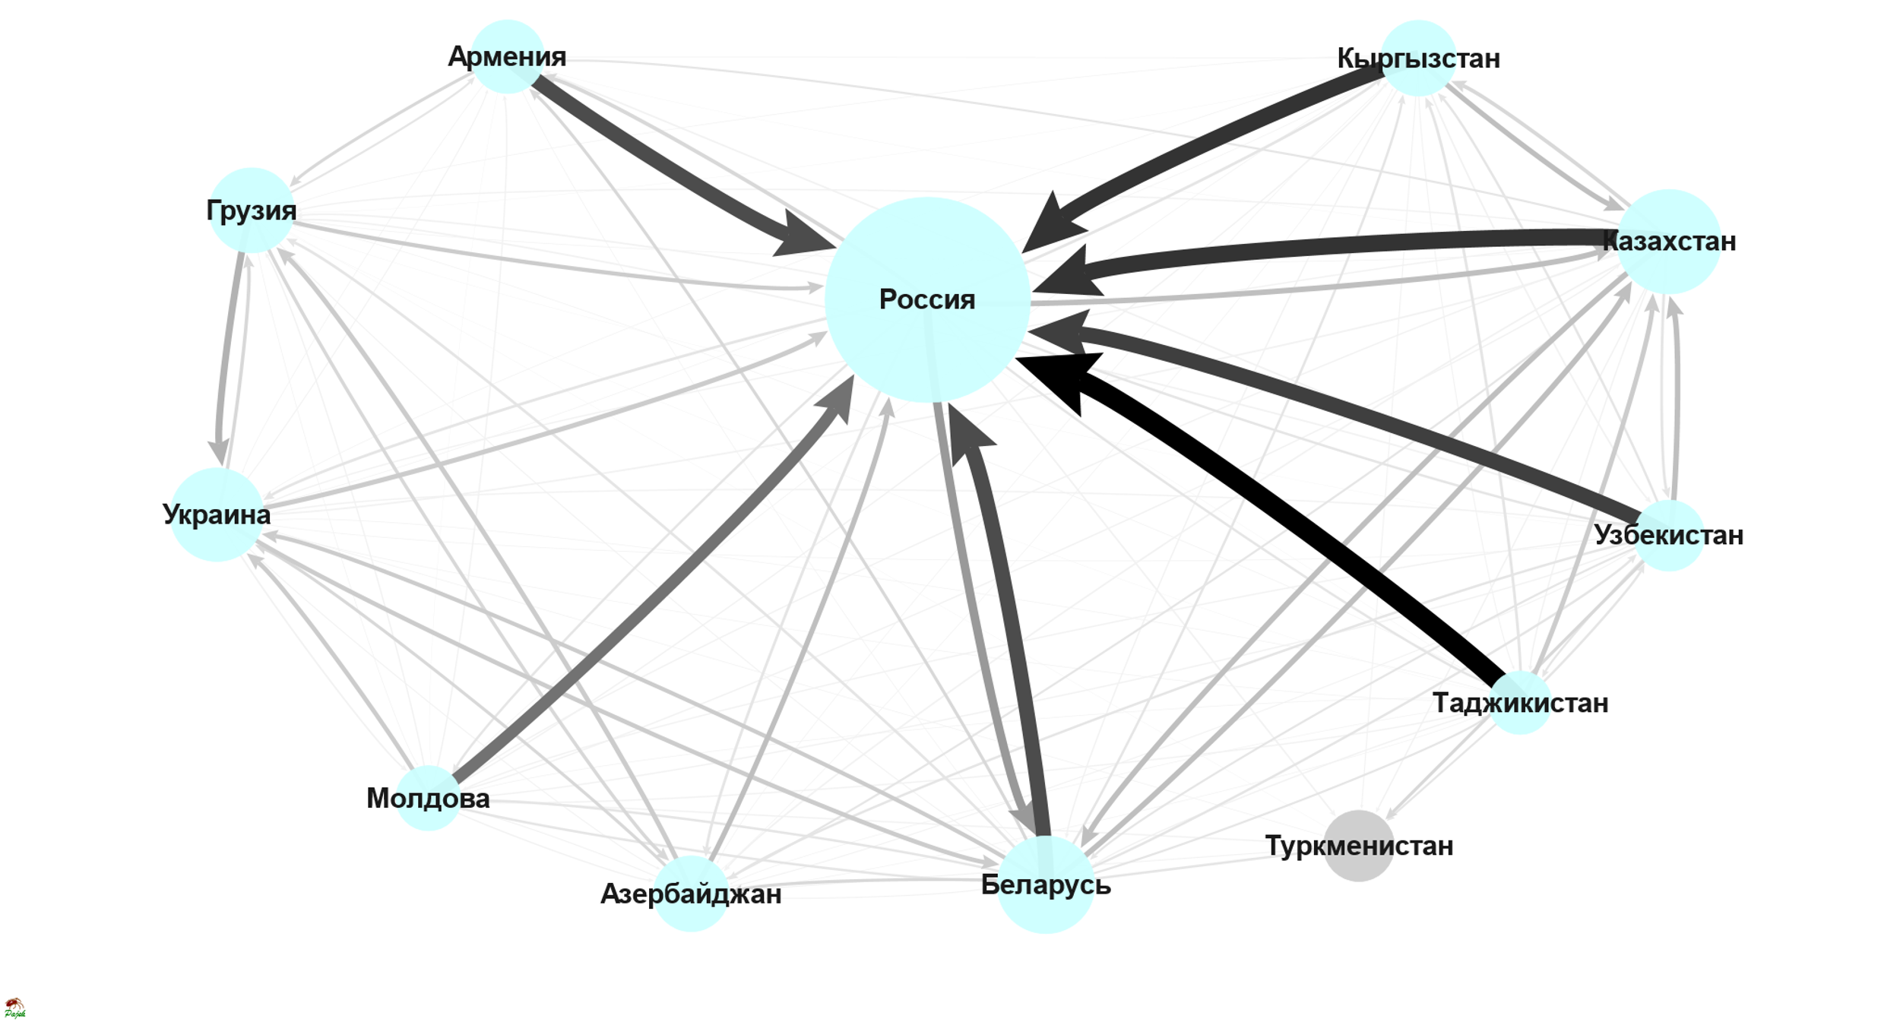
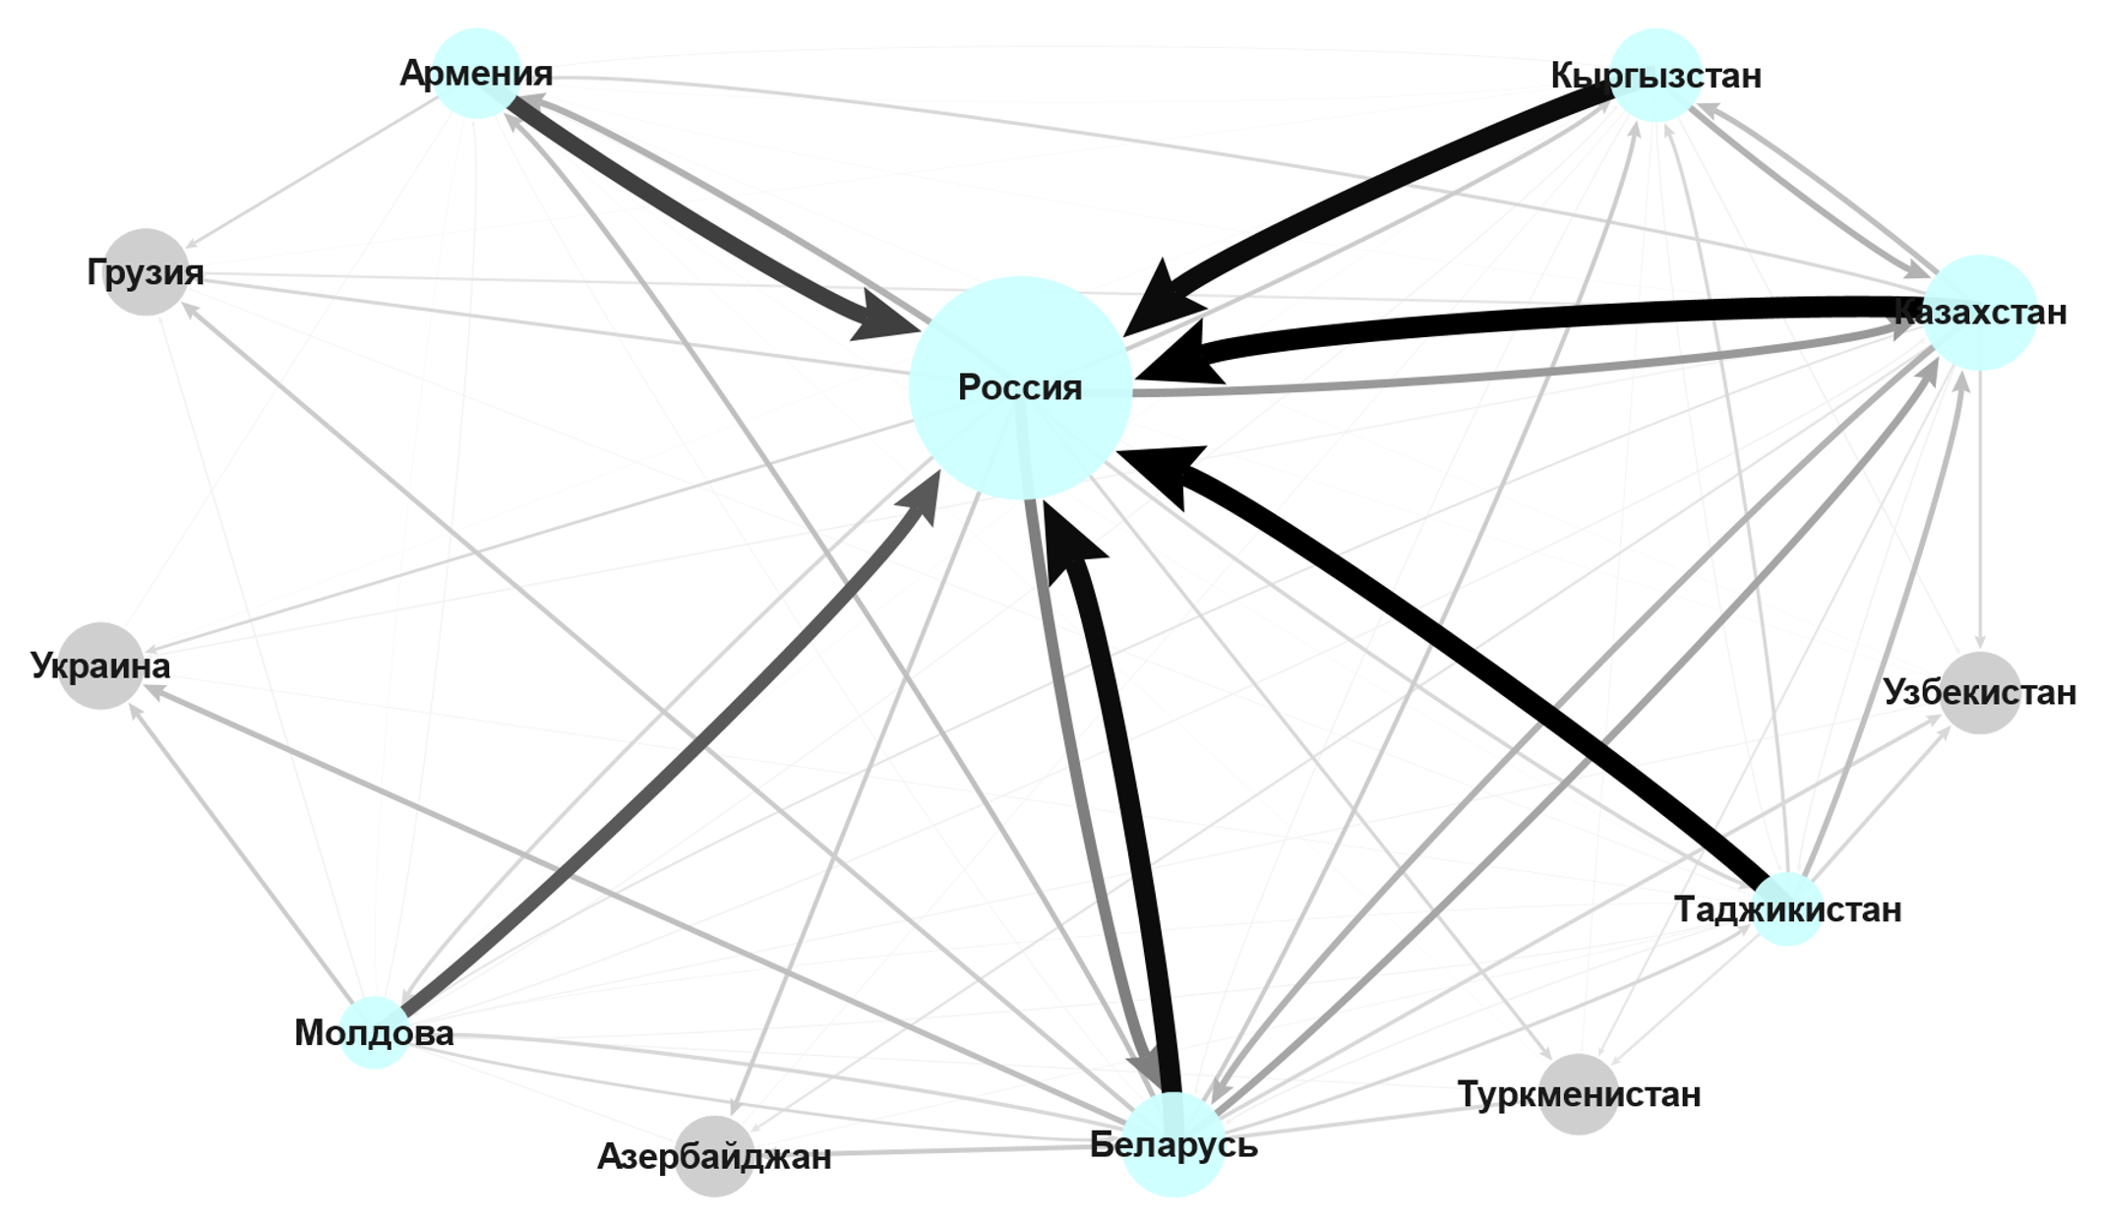
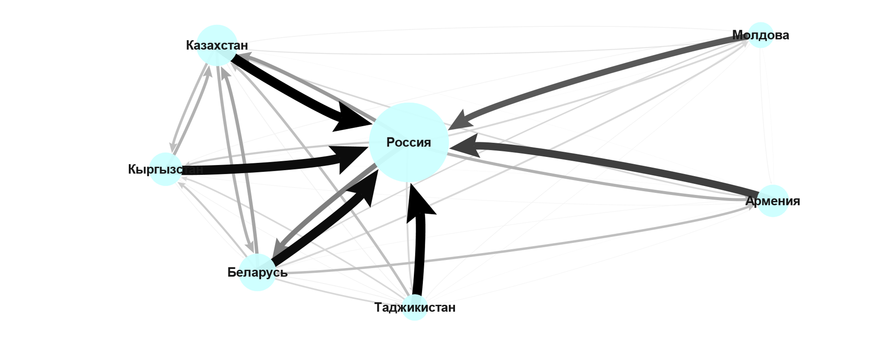
General attraction
2012-2013
2014-2015
2016-2017

Slide 32
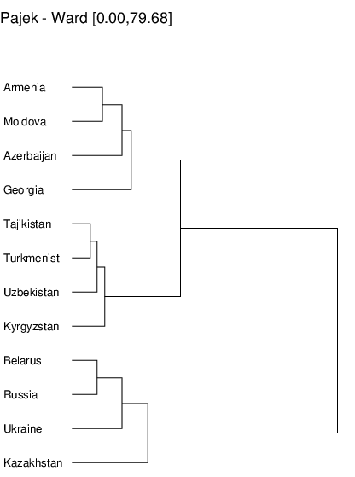
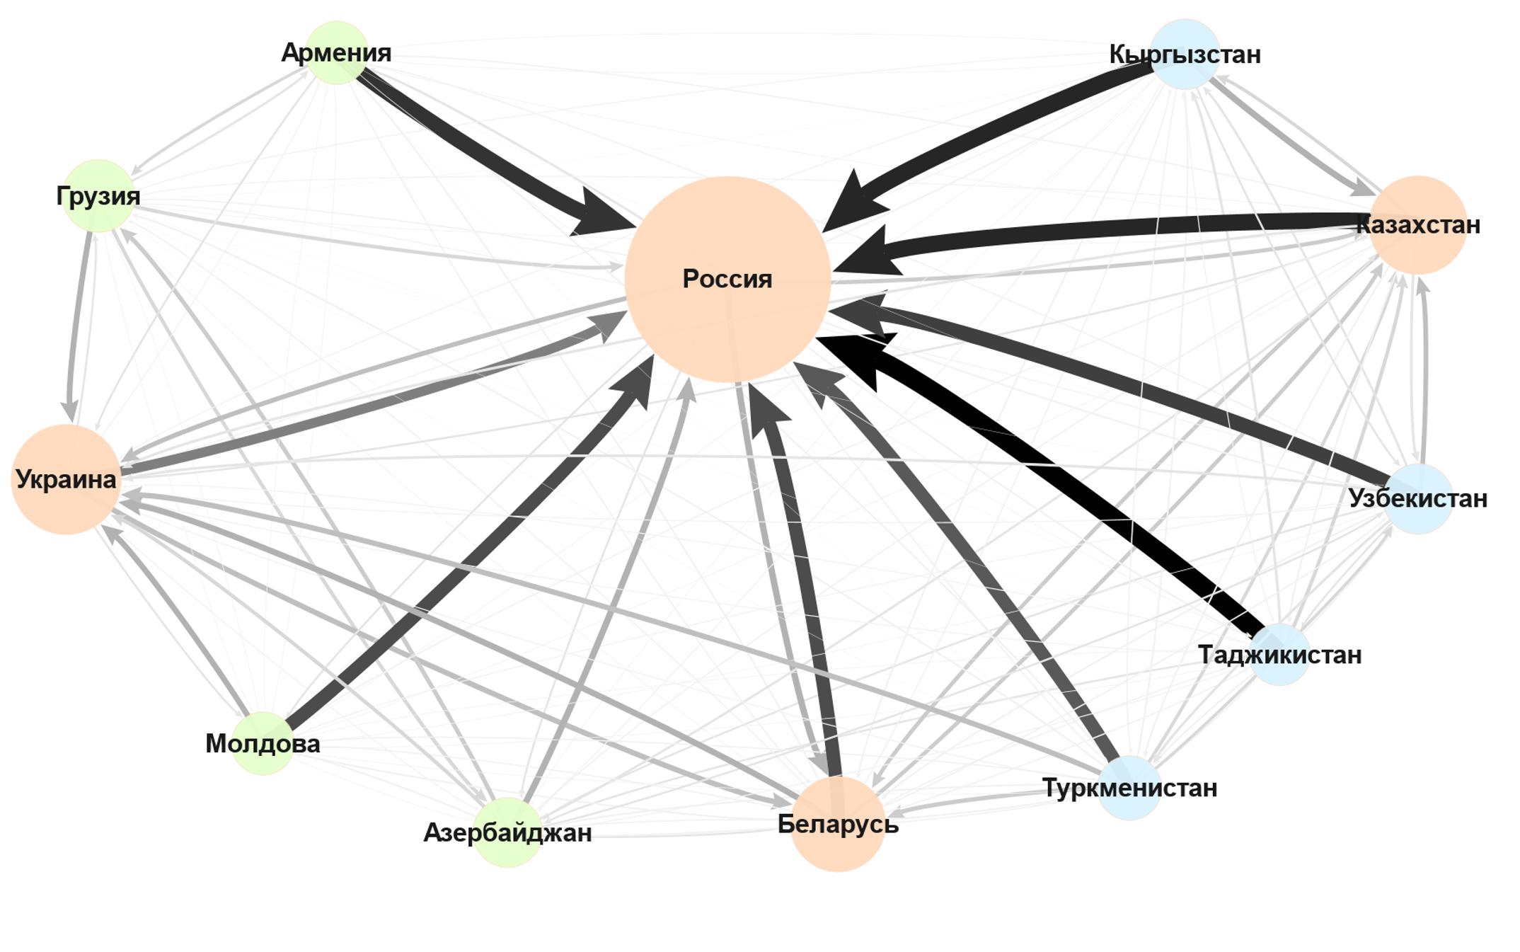
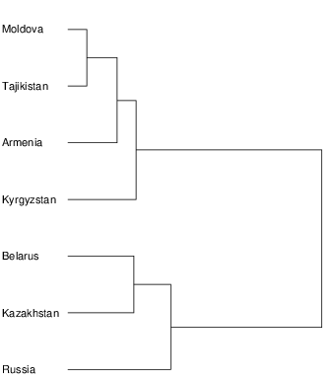
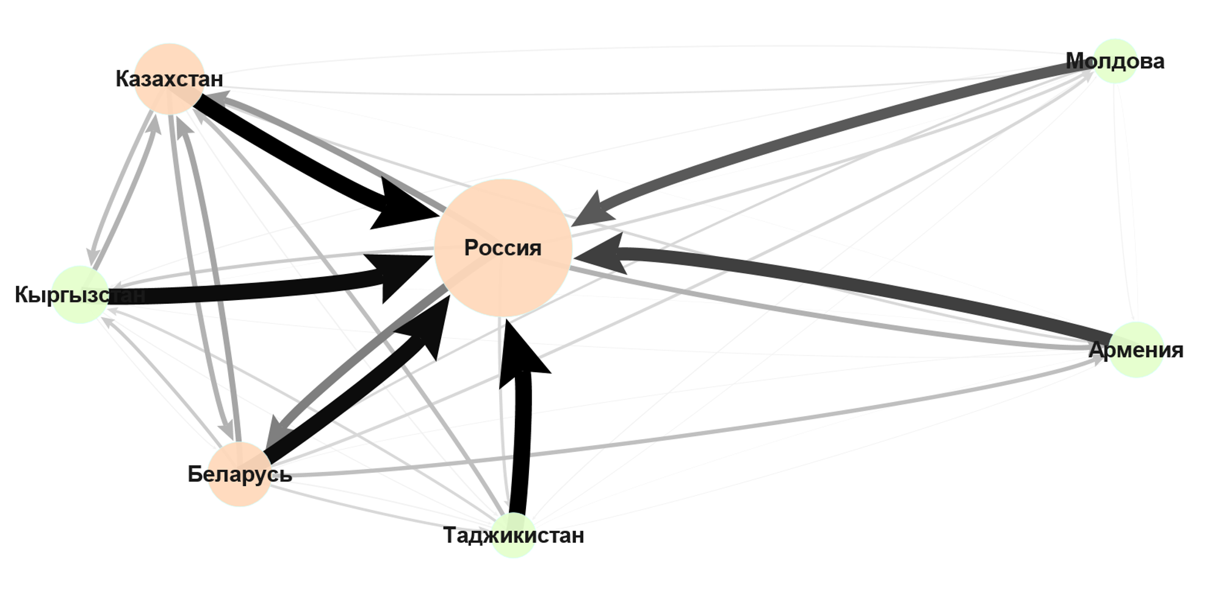
General attraction
2012-2013
3) Countries with the dominated orientation to the countries outside of the CIS
2) Countries with dominated orientation to Russia
1) Countries with the high level of connections with each other
2016-2017
2 )Periphery of the Eurasian Economic Union
1) Core of the Eurasian Economic Union

Slide 33
Conclusions and limitations
The countries of the CIS do not have the same orientations to each other. They can be grouped according to the poles:
Orientations to Russia ←→ Orientations to other countries (EU, USA)
Orientations to the countries inside the CIS ←→ Orientations to the countries outside the CIS
Being a part of the Eurasian Economic Union ←→ Being a periphery of the Eurasian Economic Union
In many cases, it means orientation to Russia (with most active Belarus and Kazakhstan) or orientation outside of the CIS (with most active Ukraine, Georgia, Moldova, and Azerbaijan).
The relations between Russia and Ukraine have significantly changed from 2012.
Limitation:
Declarative character of data (mass survey) – the results should be can be complemented by the objective data (statistics, data one the movement of people, etc.).
Not complete set of countries taking part in the study in 6 waves.
No data for 2018 – 2019 – update for the surveys is needed.
We should be sure that the representative samples in the countries remain the same.

Slide 34
Thank you!
d_malceva@mail.ru
www.anr.hse.ru
anr@hse.ru
www.facebook.com/anrlab

Slide 35
Association:
The future of the union?
Nothing will change
Difficult to say

